Slide 1

UNIVERSITY INSTITUTE OF ENGINEERING
COMPUTER SCIENCE ENGINEERING
Computer Vision (CST-422)
Prepared By : Payal Thakur(E12720)
Topic: Final Project: Introduction to the Traffic Flow Project ,Integrating Your Code
DISCOVER . LEARN . EMPOWER

Slide 2
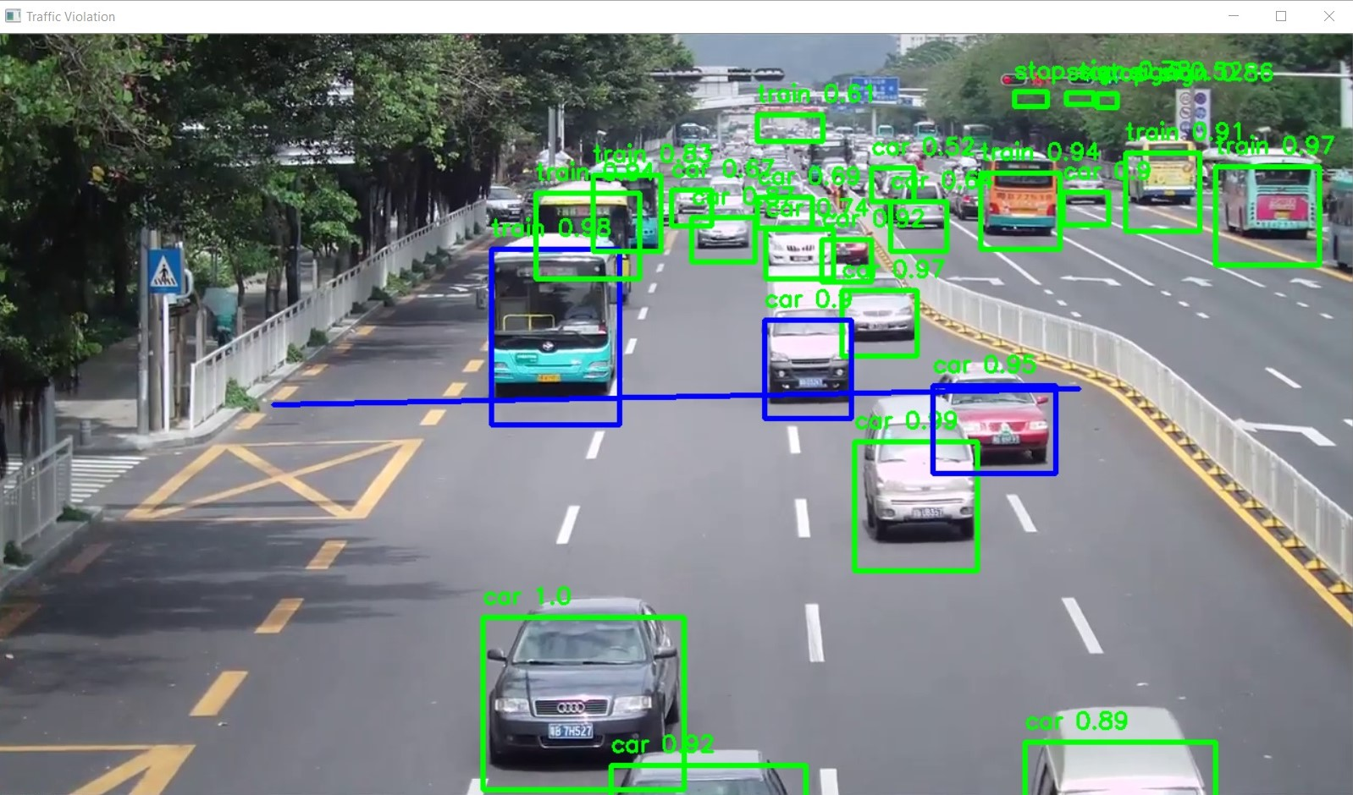
Final Project: Introduction to the Traffic Flow Project

Slide 3
Overview
The Traffic Flow Project aims to develop a system that can analyze and monitor traffic patterns in a given area using computer vision techniques.
The project involves detecting and tracking vehicles, estimating their speeds, and analyzing the overall traffic flow.

Slide 4
Project Objectives
Develop algorithms for vehicle detection and tracking.
Estimate vehicle speeds using motion analysis techniques.
Analyze traffic flow patterns and generate meaningful insights.
Visualize the results for easy interpretation.

Slide 5
Key Steps in the Project
Preprocessing: Extracting frames from videos, resizing, and normalizing them for analysis.
Vehicle Detection: Utilizing object detection algorithms to locate and identify vehicles.
Vehicle Tracking: Applying tracking algorithms to follow vehicles across frames.
Motion Analysis: Estimating vehicle speeds using optical flow or other motion estimation techniques.
Traffic Flow Analysis: Analyzing the collected data to gain insights into traffic patterns.
Visualization: Presenting the results in a visually informative and intuitive manner.

Slide 6
Code Structure and Modular Design
Divide your project code into modules or functions, each responsible for a specific task.
This modular design promotes code organization, reusability, and maintainability.

Slide 7
Integration Workflow
Begin by ensuring that each individual module works correctly in isolation.
Gradually integrate the modules, testing their interactions and resolving any issues that arise.
Use proper version control practices to manage changes and collaborate effectively.

Slide 8
Testing and Evaluation
Develop comprehensive test cases to validate the functionality of your integrated code.
Evaluate the performance of your code using appropriate metrics and the provided ground truth data.

Slide 9
Error Handling and Robustness
Implement error handling mechanisms to handle unexpected scenarios and input variations.
Ensure your code can handle different lighting conditions, weather conditions, and camera perspectives.

Slide 10
Optimization and Performance
Optimize your code for efficiency and speed where necessary.
Consider utilizing parallel processing or GPU acceleration to enhance performance.

Slide 11
References:-
Books:-
"Introduction to Computer Vision" by David Forsyth and Jean Ponce. Chapter 6: Features and Descriptors provides an in-depth explanation of feature detection, extraction, and matching algorithms.
Computer Vision: Algorithms and Applications" by Richard Szeliski. Chapter 4: Image Features covers various feature detection, extraction, and matching techniques.
Video Links
"Feature Detection and Description" by Stanford University - Computer Vision (CS231n). Available on YouTube: https://www.youtube.com/watch?v=H-HVZJ7kGI0
"Feature Matching and Homography" by University of Washington - Computer Vision (CSE 576). Available on YouTube: https://www.youtube.com/watch?v=uvSCXyYpG9k
"Introduction to Feature Detection and Matching" by OpenCV. Available on YouTube: https://www.youtube.com/watch?v=AWoG8vdw4pA

Slide 12
THANK YOU
For queries
Email: payal.e12720@cumail.in

